Slide 1
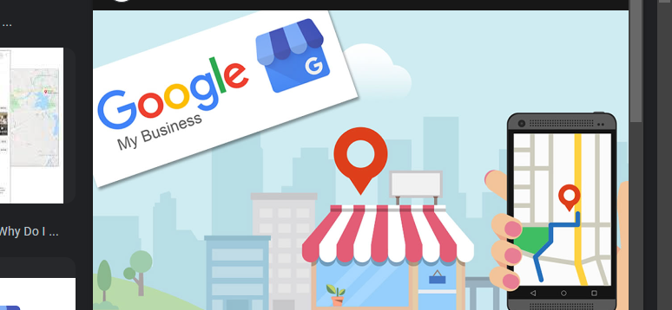
Create a Google My Business Profile
Business Profile For Restaurant

Slide 2
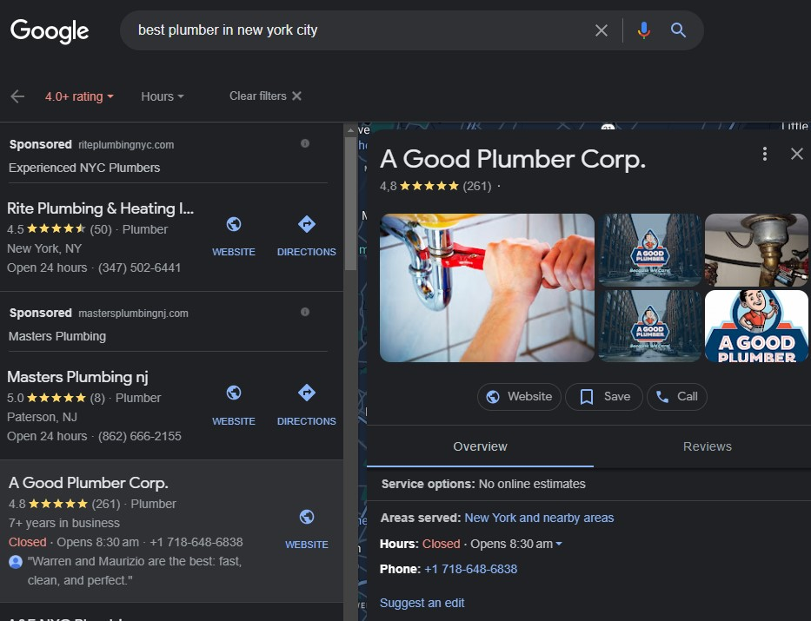
About Google My business Profile
Google My Business (GMB) is a free and user-friendly tool provided by Google to help businesses and organizations manage their online presence on Google's search engine and Google Maps. It's a critical component of local search engine optimization (SEO) and is particularly useful for brick-and-mortar businesses, service providers, and other entities with a physical location.

Slide 3
Here are some key aspects and features of a Google My Business profile:
Business Information: You can provide detailed information about your business, including its name, address, phone number, website, business category, and hours of operation. This data helps potential customers find and contact your business.
Location on Google Maps: Your business's location is displayed on Google Maps, making it easy for customers to find your physical address. It's especially valuable for local businesses.
Photos and Videos: You can upload images and videos to showcase your products, services, interior, exterior, and team. High-quality visuals can help attract potential customers.
Customer Reviews: Customers can leave reviews and ratings for your business. Managing and responding to these reviews is important for building and maintaining your online reputation.
Posts and Updates: You can create and publish posts to share updates, offers, events, or news about your business. These posts can appear in Google search results.

Slide 4

Analytics: GMB provides insights into how users interact with your profile. You can see data on how often your profile appears in search results, how many users click on your website link, and more. Booking and Appointments: If your business offers appointments or reservations, you can integrate this feature into your GMB profile, making it easier for customers to schedule. Products and Services: You can list your products and services with descriptions and pricing, making it convenient for customers to see what you offer. Website Builder: Google My Business offers a simple website builder that allows you to create a basic website for your business, including a custom domain.

Slide 5

Google My Business (GMB) profiles are beneficial to both small and large businesses for several reasons, as they help enhance their online presence, engage with customers, and drive growth. Here's how GMB can be useful to businesses of all sizes:

Slide 6

Create My Business Profile For South Indian Restaurant
Following are the steps to create My Business Profile:

Slide 7
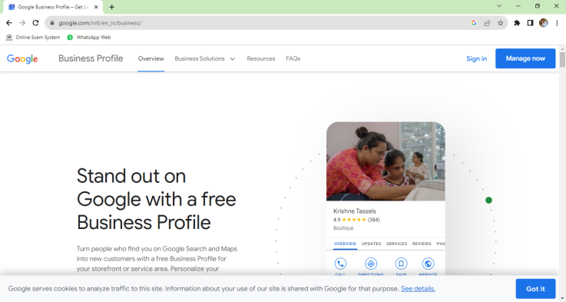
STEP 1: Visit Google My Business: Go to the Google My Business website at https://www.google.com/business/

Slide 8
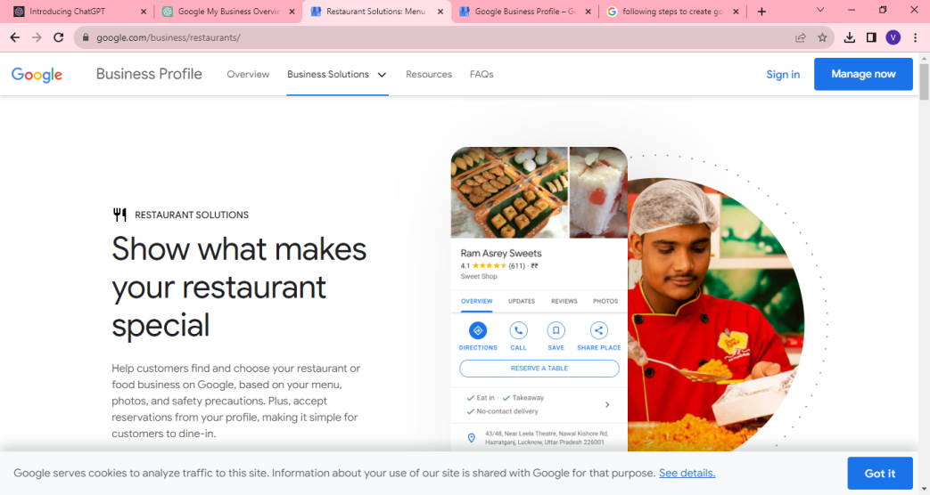
STEP 2: Sign In or Create an Account: If you already have a Google account, sign in. If not, you'll need to create one. Follow the prompts to either sign in or create a new Google account.

Slide 9
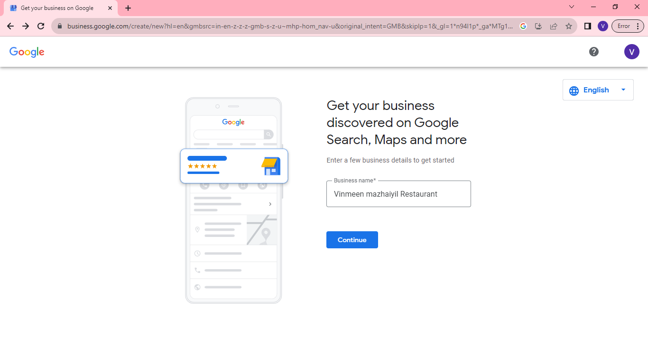
STEP 3: Enter Your Business Name: Enter the name of your business. Make sure it matches your official business name.

Slide 10
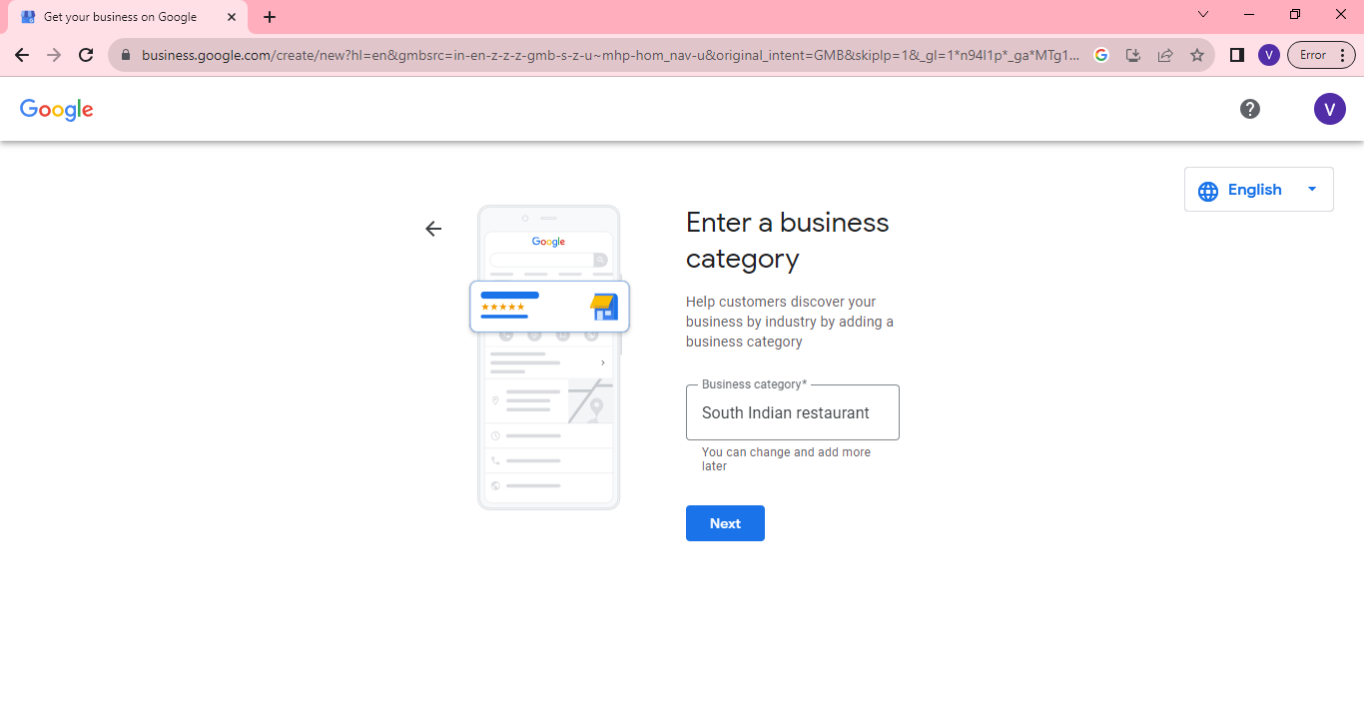
STEP 4: Enter a Business Category:Choose a category that best describes your business. This helps Google understand what your business is about.

Slide 11
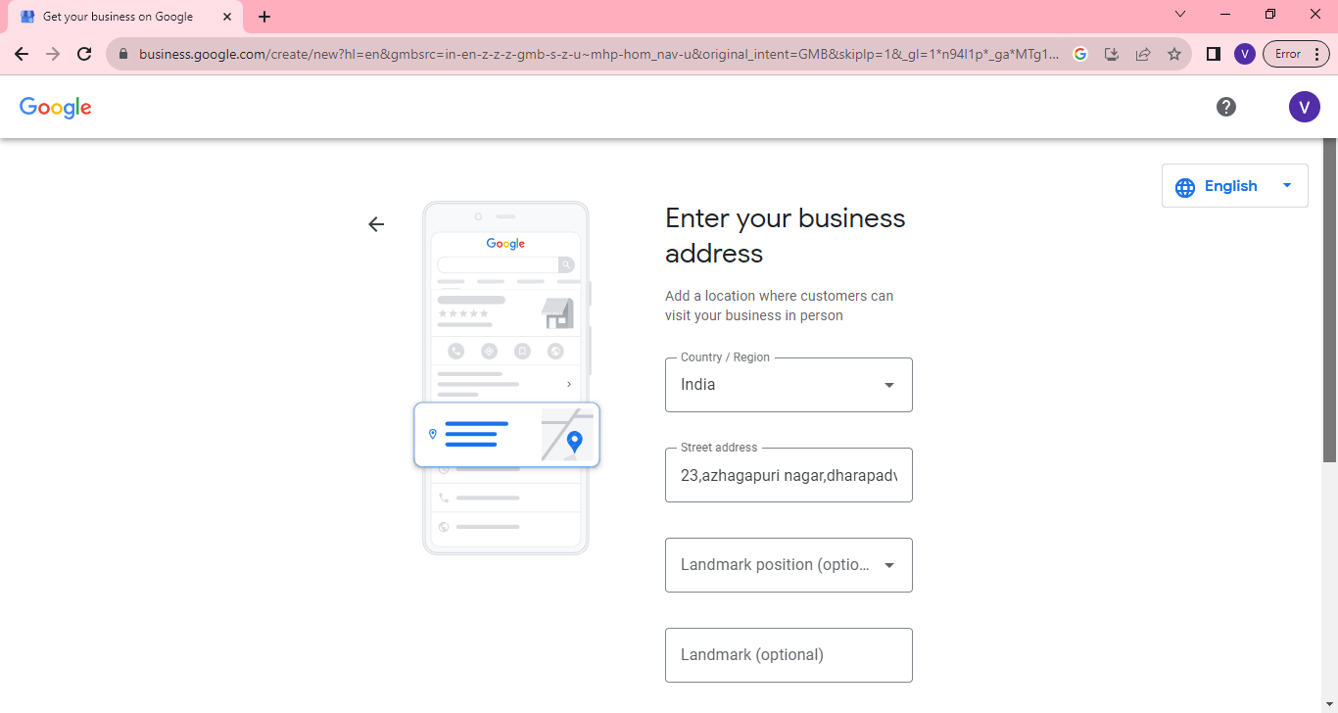
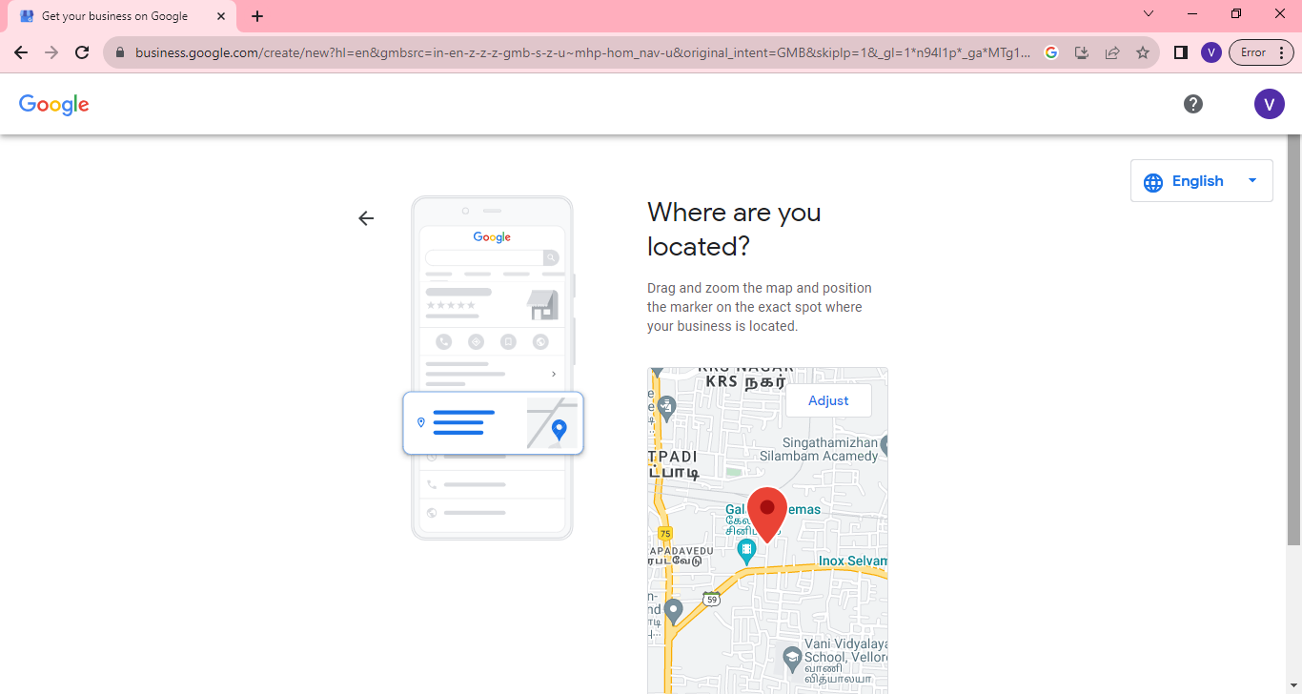
STEP 5: Enter Your Business Location: If your business has a physical location that customers visit, enter the address. If your business is online or doesn't have a physical storefront, you can select "I deliver goods and services to my customers" and then choose to hide your address if necessary.

Slide 12
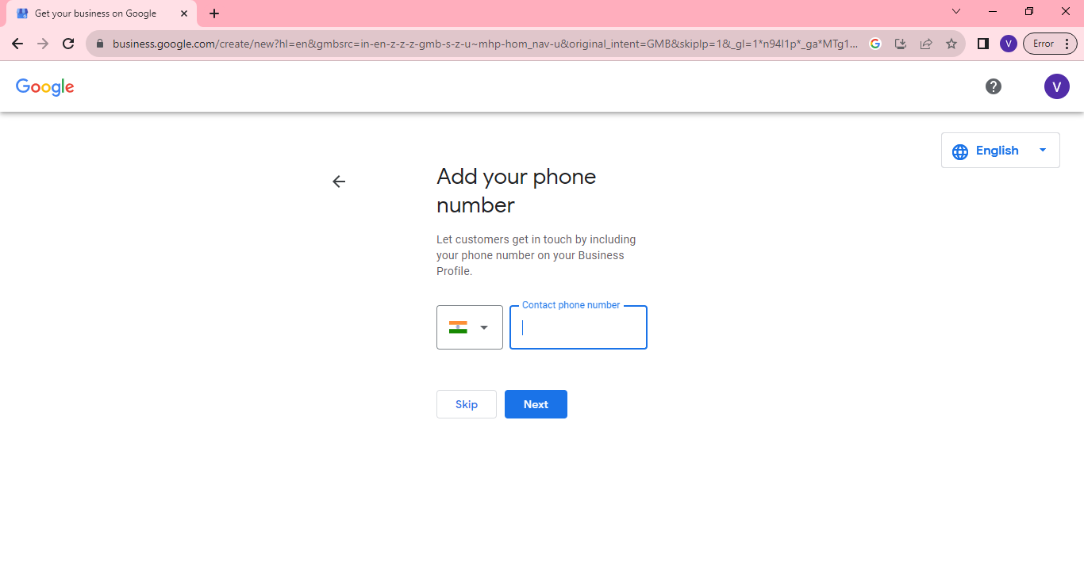
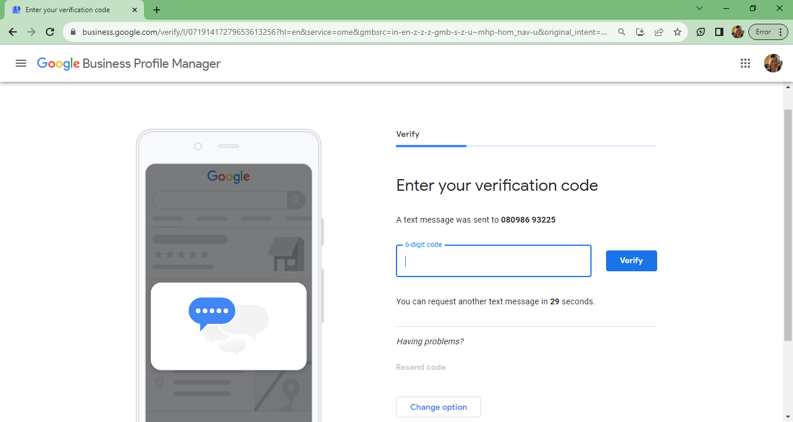
STEP 6: Add Contact Information: Enter your business phone number and website (if applicable). These details help customers contact you and find more information.

Slide 13
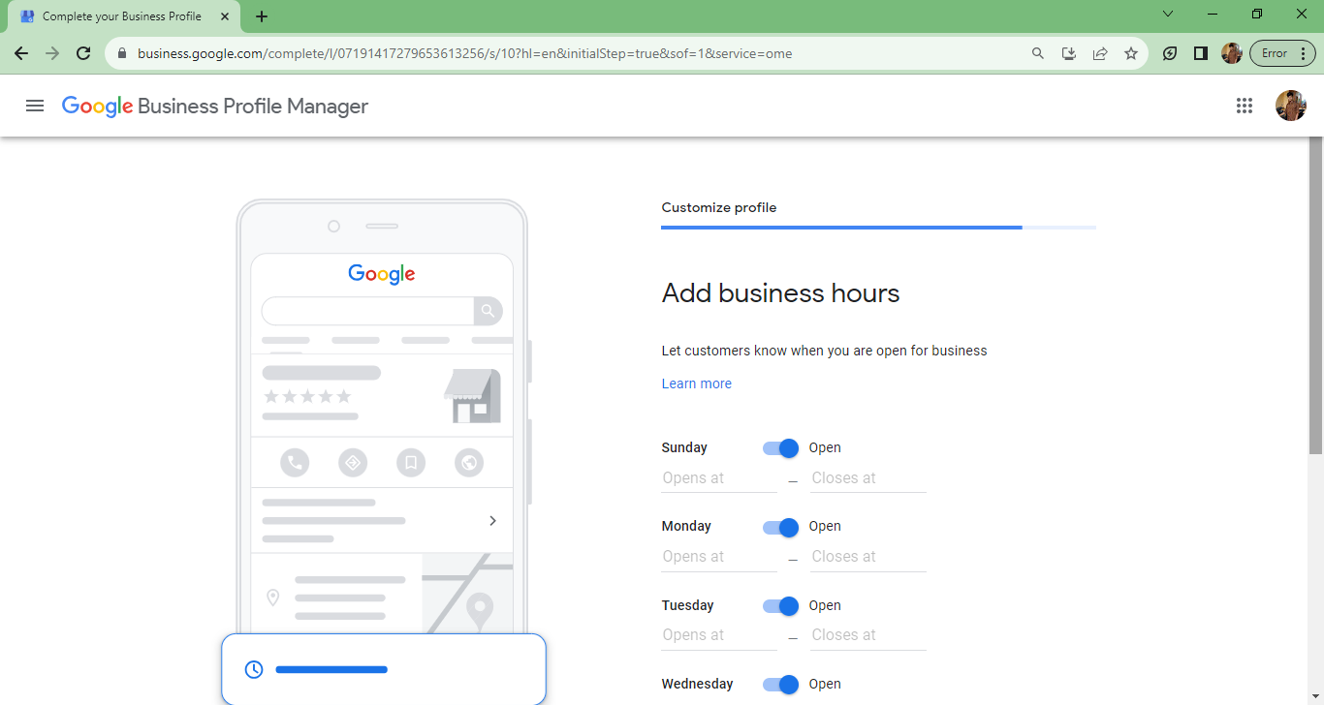
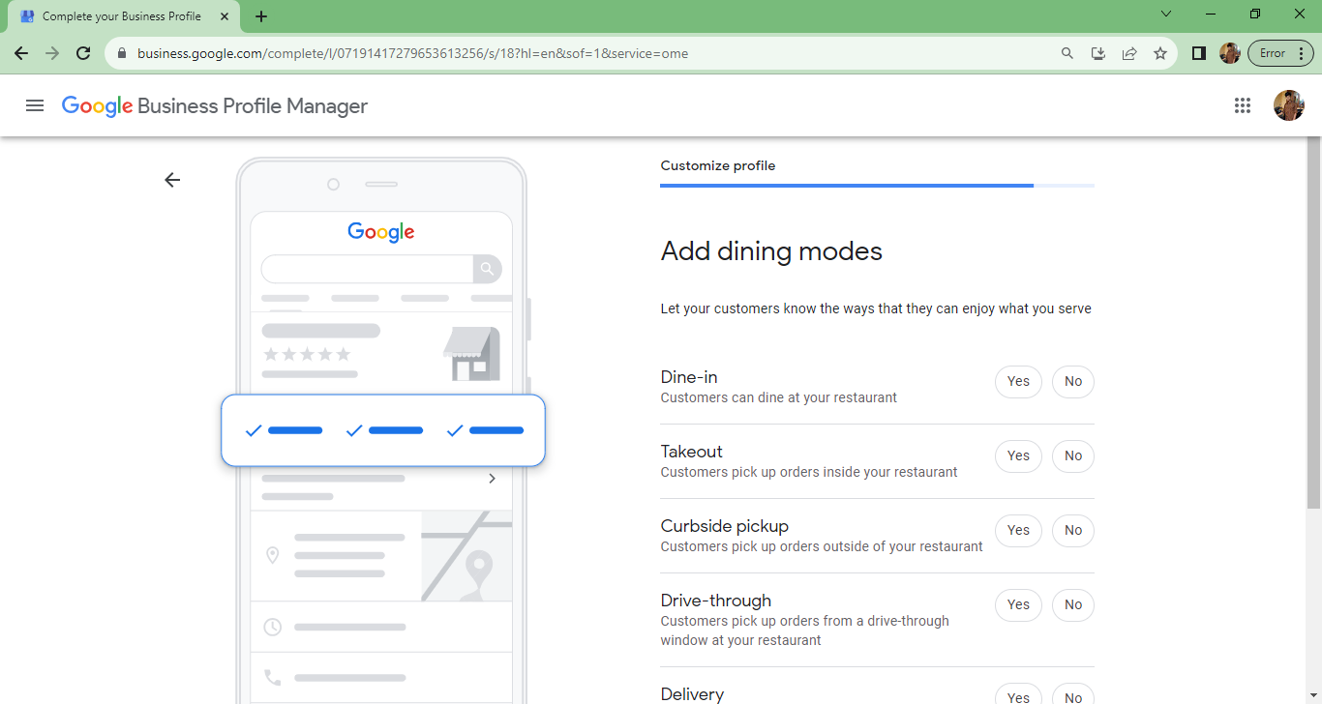
STEP 7: Adding Business Hours and Add Dining Modes: It's important to keep your GMB profile updated with any changes to your business, such as new hours, special promotions, or different products or services.

Slide 14
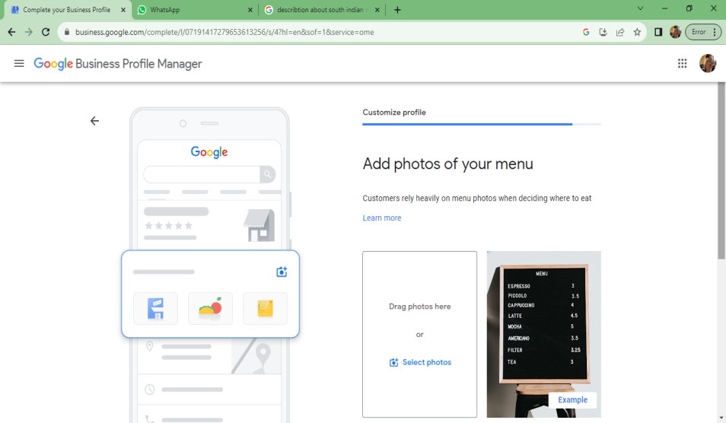
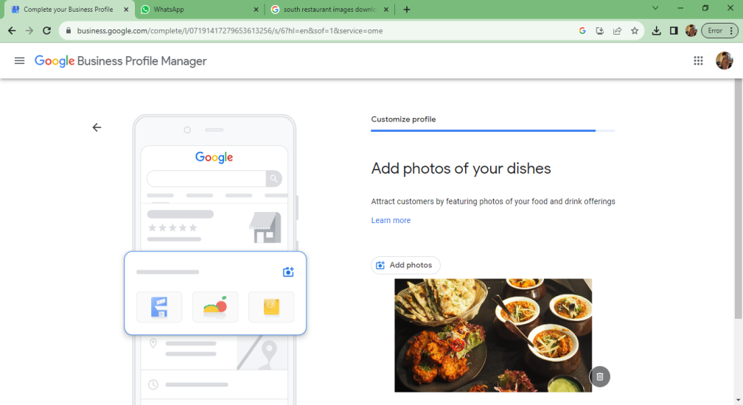
STEP 8: Add Photos Of Your Menus And Dishes: you can enhance your profile by adding more details. This includes uploading photos of your business, adding hours of operation, writing a business description, and providing information about products or services you offer.

Slide 15
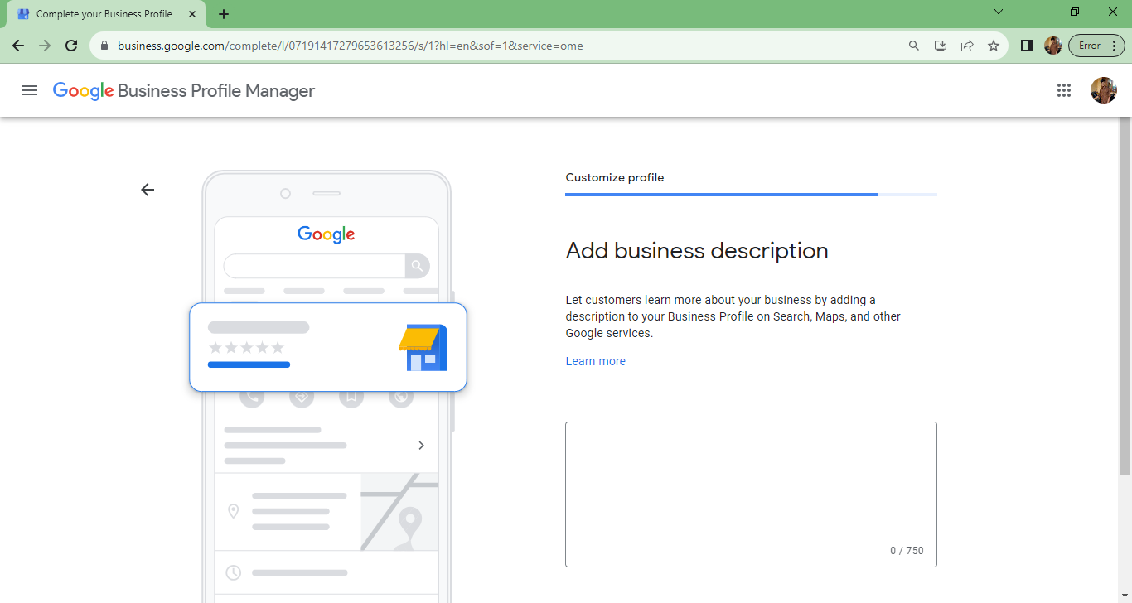
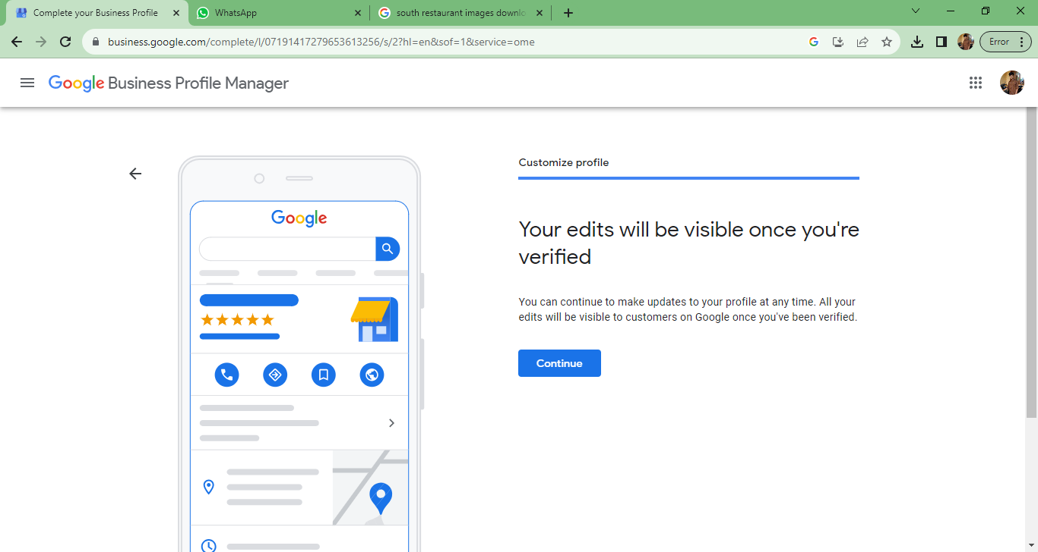
STEP 9: After Enter Business Description The Business Profile Get Verified

Slide 16
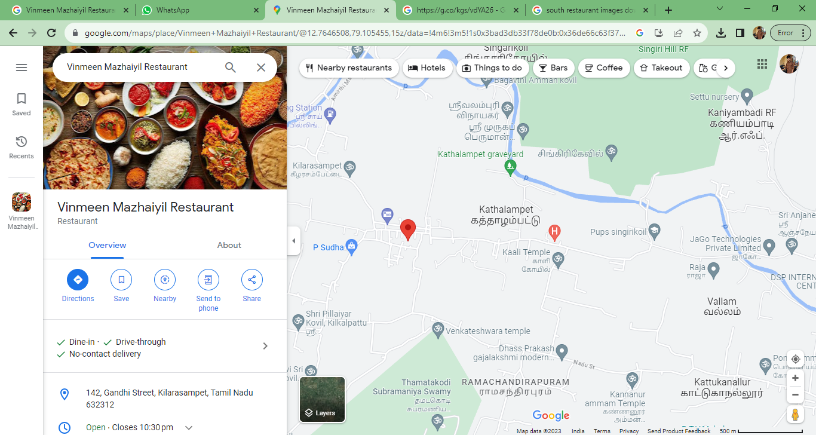
STEP 10: It is the Final Step Your Google Business Profile Created Succesfully

Slide 17

Business Profile Website Link: https://maps.app.goo.gl/j8vEQsw8zn7d9WCL6 YouTube Video Link: https://youtu.be/bVBpd8Q46FU?si=RldHv8_D5nuSZARx

